Slide 1
HTTP5110
Week 4: Minimum viable product (MVP) & Github Pages
Notes:
Content Slide with Image

Slide 2
Github Pages: Host your static website
GitHub Pages is a static site hosting service that takes HTML, CSS, and JavaScript files from a repository on GitHub and publishes a website.
Set up a Repository
Create your site
Notes:
Content Slide with Image

Slide 3
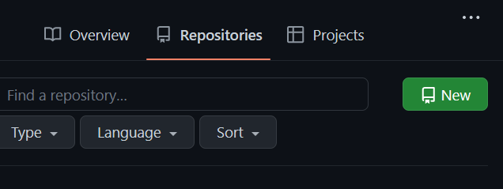
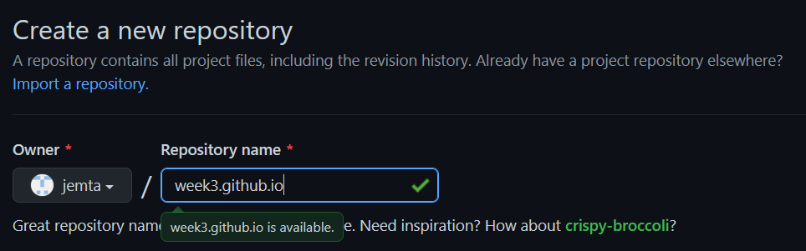
Github : Set up repository 1/2
Login to Github. Let’s create a new repository:
2. Name your repository. The repo name must be <user>.github.io in lowercase
Notes:
Content Slide with Image

Slide 4
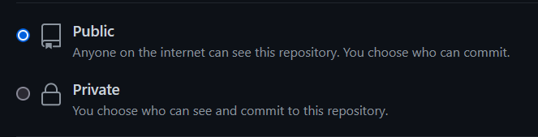
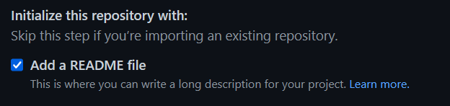
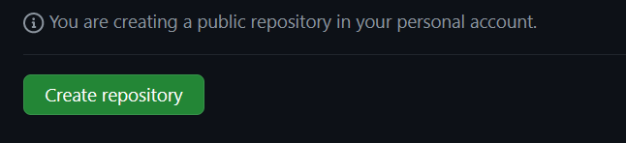
Github pages: Set up repository 2/2
3. Choose the visibility.
4. Do not add a readme file
5. Click on “Create repository”
Notes:
Content Slide with Image

Slide 5
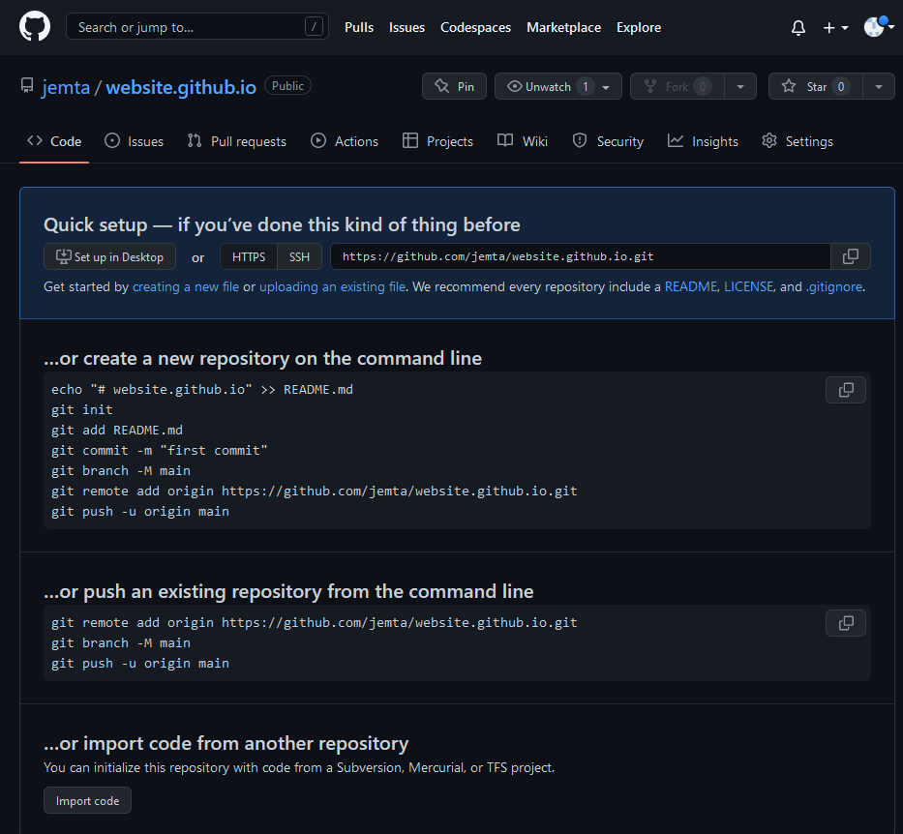
Your repository is set up:
We will circle back to the README.md file….
Notes:
Content Slide with Image

Slide 6
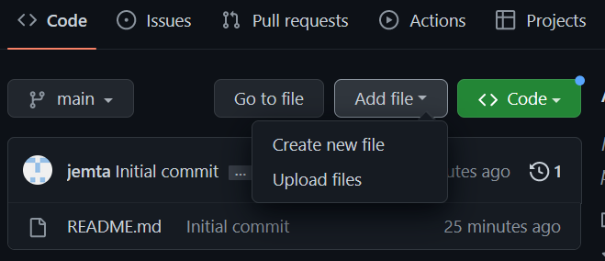
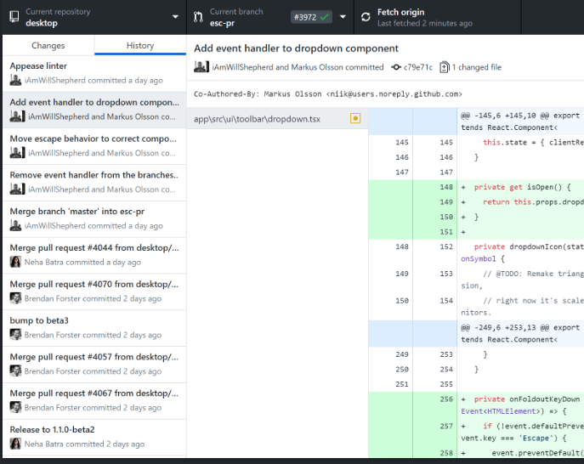
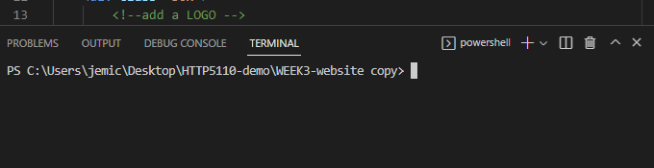

Github pages: Creating your site
With your repository set up, we are going to add your Week 3 website.
There are several ways to add files:
Upload files by dragging and dropping
(2) Use Github desktop
(3) Use terminal on VS code
Notes:
Content Slide with Image

Slide 7
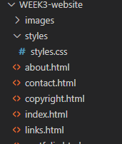

Github pages: Creating your site
In order to publish your site, Github pages will look for an index.html file as an entry file for your site.
*** Note: GitHub Pages sites are publicly available even if the repository for the site is private. Remove any sensitive data before publishing.
Notes:
Content Slide with Image

Slide 8
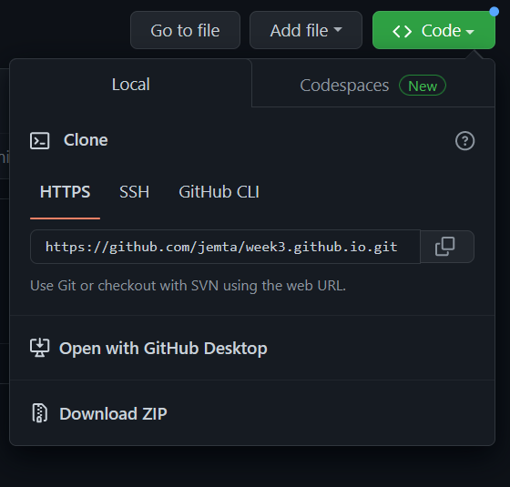
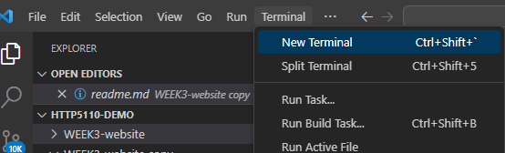
Github pages: Uploading folder to repository
1. Open VS code. Go to the top navigation and click on “Terminal” > New Terminal
In your terminal, Initialize your repo. This means you are setting up your local repo to transport your folders and files to Github
Git init
Notes:
Content Slide with Image

Slide 9
Github pages: Uploading folder to repository
3. Get your folder and contents ready to transfer. Type the following
git add .
git commit –m “your message”
git remote add origin https://github.com/jemta/week3.github.io
git push --set-upstream origin main
Notes:
Content Slide with Image

Slide 10
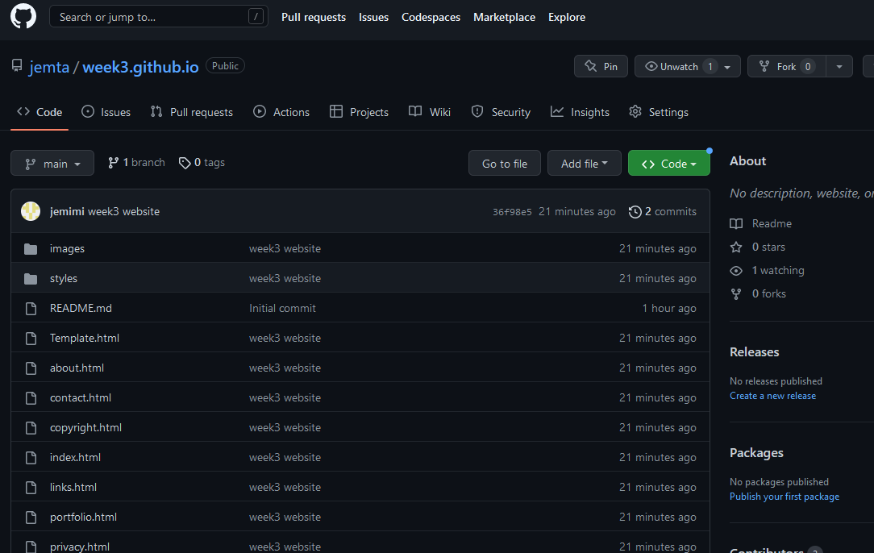
Folder uploaded to Github! ☺
Notes:
Content Slide with Image

Slide 11
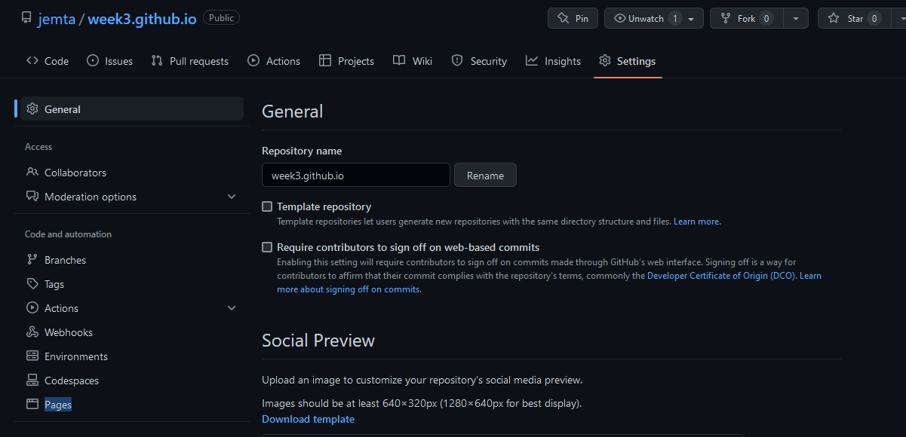
Github pages: Turn on pages
4. Click on “Setting” in your repository
5. Under “Code and automation”, click “Pages”
Notes:
Content Slide with Image

Slide 12
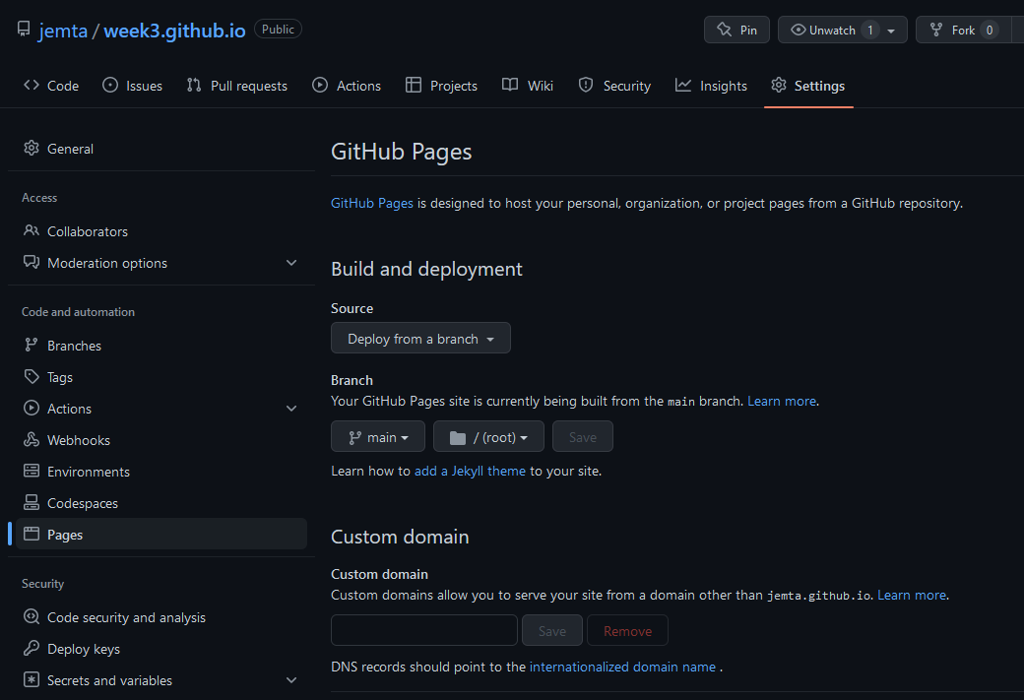
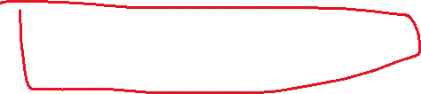
Github pages: Turn on pages
6. Click on Branch and select “main”. It may take a few minutes for Github to build the site
Notes:
Content Slide with Image

Slide 13
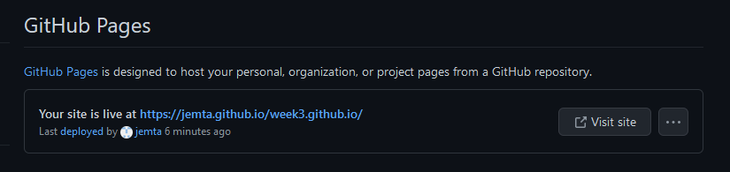
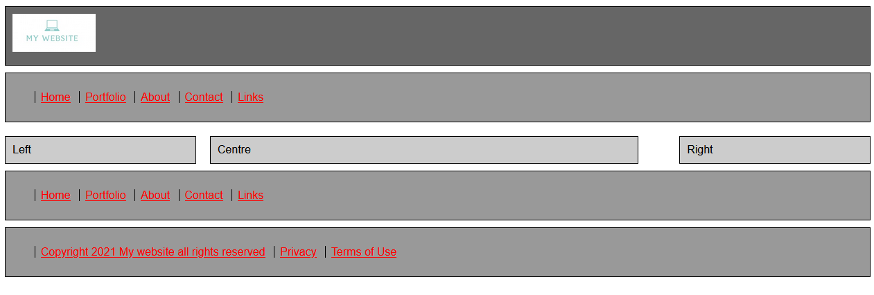
Github pages: Live site
7. Once the site is built, you will see the following message. Click “Visit site” to see your published site.
Congrats! Your site is live.
Notes:
Content Slide with Image

Slide 14
README.md
First file that a person will look at
Makes your project standout from others
Helps you focus on what your project delivers and how
Answers What, Why and How of your project
What the project does
Why is it useful?
What problem did it solve?
What did you learn?
How can users set up this project?
Who maintains and contributes to this project
Source: https://docs.github.com/en/repositories/managing-your-repositorys-settings-and-features/customizing-your-repository/about-readmes

Slide 15
README.md
1. Project title
2. Project description
- What does your application do?
- What technologies did you use and why?
- Challenges
- Future features
3. How to install and run the project
- step by step of how to get the environment up and running
4. Credits & Collaborators
5. Add a license
- most common = GPL license

Slide 16
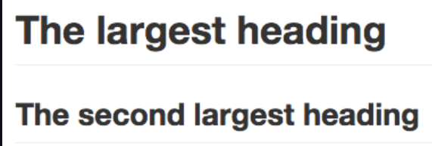


README.md = Markdown basics
Headings :
# Largest
## Second largest
Links (inline):
[text in square brackets ](link in parentheses)
Images:
- Use ! And wrap alt text [ ] + wrap link in ( )
- Use relative links.
- .md file in same branch:
Source: https://docs.github.com/en/get-started/writing-on-github/getting-started-with-writing-and-formatting-on-github/basic-writing-and-formatting-syntax

Slide 17
Minimum Viable Product (MVP)
Notes:
Content Slide with Image

Slide 18
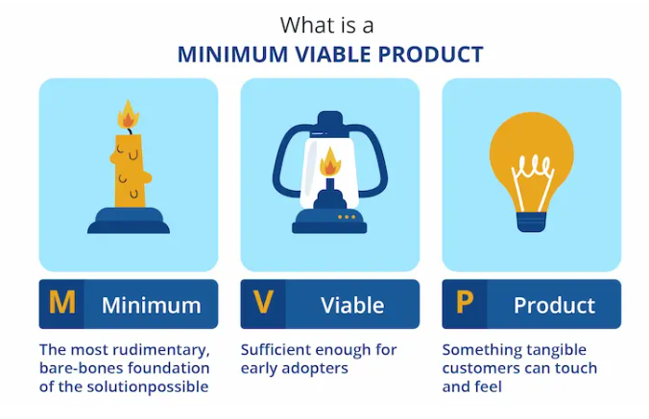
Minimum Viable Product (MVP)
a basic, launchable version of the product that supports minimal yet must-have features
Purpose is to test your product by getting user feedback – fast
Is it a viable product?
Iterate based on user feedback to improve product and build out features
Lean startup model
Make something people want !
Notes:
Content Slide with Image

Slide 19
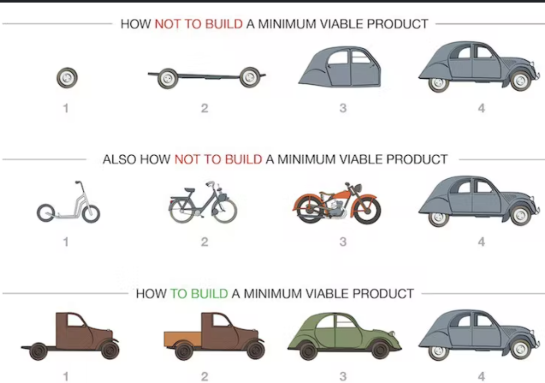
5 steps to build a MVP
Define what problem you want to solve
Conduct market research
Minimum features to launch
Build your MVP
Improve MVP based on what you learned from potential customers
Notes:
Content Slide with Image

Slide 20
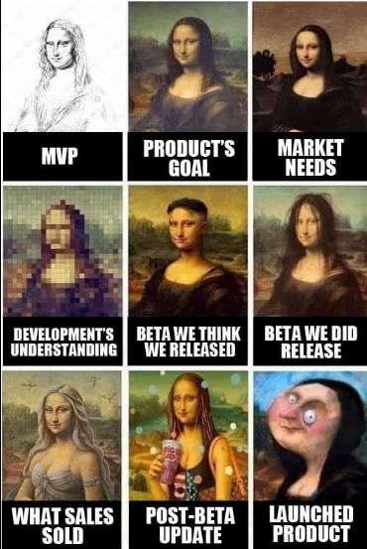
Best practices for building MVP
Keep it simple – focus on features that will solve your problem
Build a prototype – this will help validate your assumptions and get feedback
Get feedback early and often – use customer feedback to improve and iterate on your MVP
Be prepared to pivot – as you get feedback, be prepared to make changes to your product
Be scrappy – MVPs are not about perfection, they’re about learning and improving. Don’t spend too much time or money on your MVP
Notes:
Content Slide with Image

Slide 21
MVP: Content Management System (CMS)
Notes:
Content Slide with Image

Slide 22
Content Management System (CMS)
All the Web sites that you use in the course of a year are based on content management systems
CMS allows someone to change the content on the Web site without knowing how to code.
Facebook, eBay, Tiktok, Twitter, Dropbox, Buffer, Medium
CRUD: Create, Read, Update, and Delete.
Have a page,
Have a link to the page,
Have links to all pages,
Have a means to add pages, delete pages, and update pages.
Have a database to hold the content.
Notes:
Content Slide with Image

Slide 23
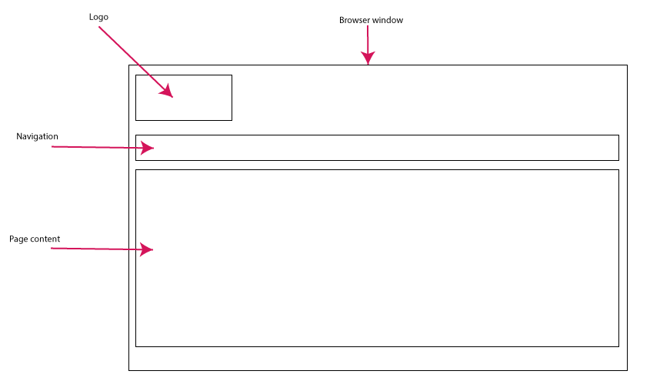
CMS: paged content
Content that is added to the databased is content managed by our system
Contents = paged content
About
Copyright
Content is managed with CRUD
Create
Read
Update
Delete
a wireframe version of the MVP
Public view – Read of CRUD
Notes:
Content Slide with Image

Slide 24
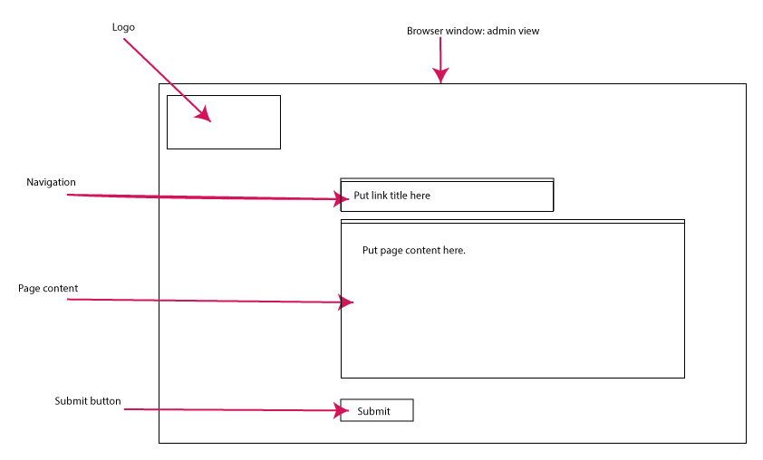
MVP:
2 components managed by CRUD
Add a page
Add a link to that page
HTML form view – Create and Update of CRUD
Notes:
Content Slide with Image

Slide 25
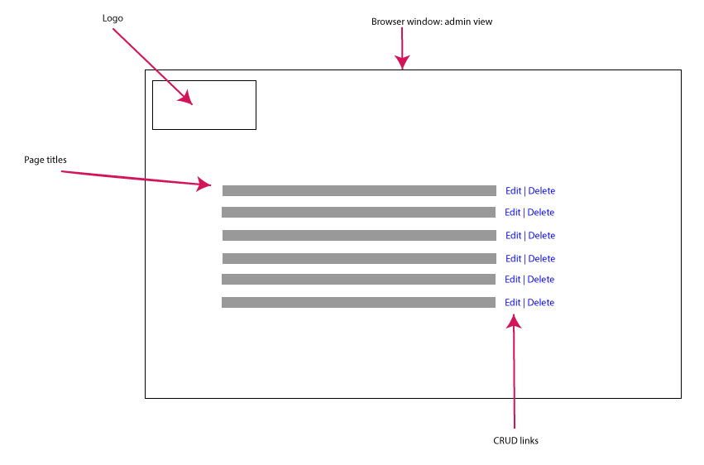
MVP
output page that generates a list all of the pages entered into the database.
each page reference (a link to that page) would be options to edit or delete.
button or link to create a new page
A listing of all pages – select either Edit or Delete – Update or Delete in CRUD.
Notes:
Content Slide with Image

Slide 26
Add a new page feature
What other features can you add?
A page has a title, body content, navigation term, the ability to add images, and perhaps other documents like PDF files.
Think of text fields as an HTML form that issues commands to the database.
Your database now has several columns for each of these elements including a link to the menu system.
Start with text areas – then adding elements to the MVP is easy to do.
Remember MVP – “minimum” viable product – do not add too many of these new elements at the same time.
Notes:
Content Slide with Image

Slide 27
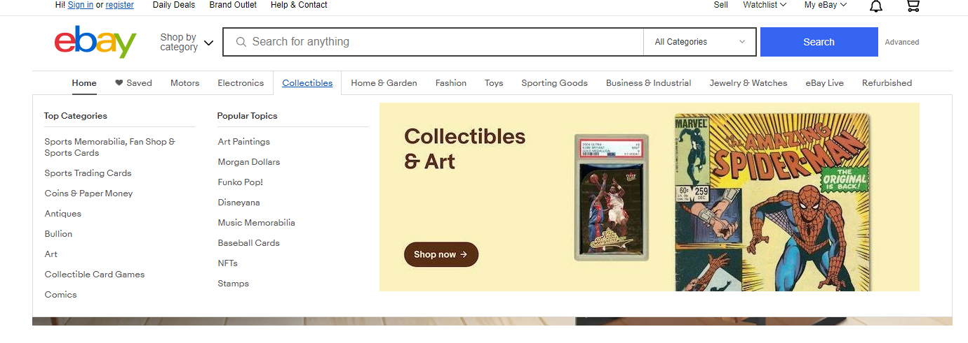
Adding links to the menu feature
Menu system = web site navigation that is on every page.
essence of creating a scalable Web site.
Adding content is means of adding navigation.
pages = main navigation
adding products = navigation to the products pages
Creating a series of links
main navigation = parent links
secondary navigation = child links.
Database would have to account for this parent and child relationship.
For the MVP = primary navigation.
Notes:
Content Slide with Image

Slide 28
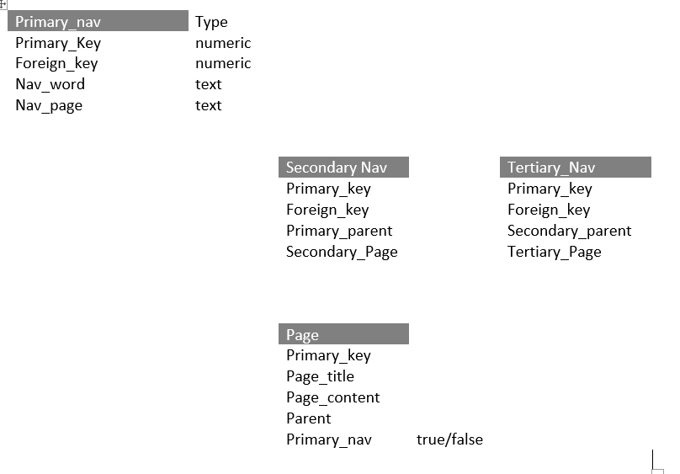
Database structure
Primary navigation, parent, subsequent tables with secondary navigation linked to the primary navigation and then linked to the individual page.
tables would be linked to the each of the pages on the Web site.
Please note: this is not a final database design. We would have to ensure that it is optimized and functional for our needs.
Notes:
Content Slide with Image

Slide 29
Summary
Github pages: easy way to host a simple site fast on your student developer account
MVP: Minimum viable product : a basic, launchable version of the product that supports minimal yet must-have features
Content management system (CMS): pages and links. As well as a means to add new pages and add new links. Or to edit those pages and links.
Notes:
Content Slide with Image

Slide 30
Assignments: Due today
Your assignment is: working in your teams and in 250 words or less describe either ebay, Facebook, or Youtube, Airbnb as an MVP. I will ask you to present your answer.
Questions to answer:
What would an MVP look like? What kind of users are there? Who can do what to the content? What can users do? One thing you can consider doing is writing a few user stories to explain how the Web site works.
“A registered user can change their password.”
You don’t have to consider all functions just enough to make the system work. That would make it the least needed to be functional.

Slide 31
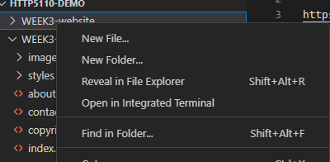


Github pages: Uploading folder to repository for multiple folders
Create your small web site on Github
Send me the working link by email.
Notes:
Content Slide with Image

